Slide 1



Natural Language as Input for and Output from Visualization Systems
Arjun Srinivasan
@10_arjun
Tableau Research

Slide 2





Natural Language
Visualizations
Humans
Visualization Systems

Slide 3
Natural Language Input
Visualizations
Humans
Visualization Systems

Slide 4
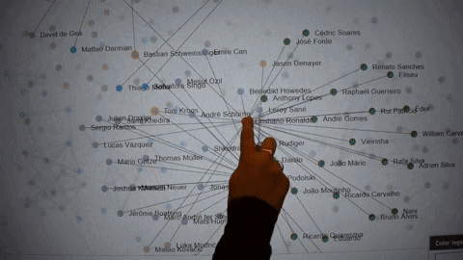
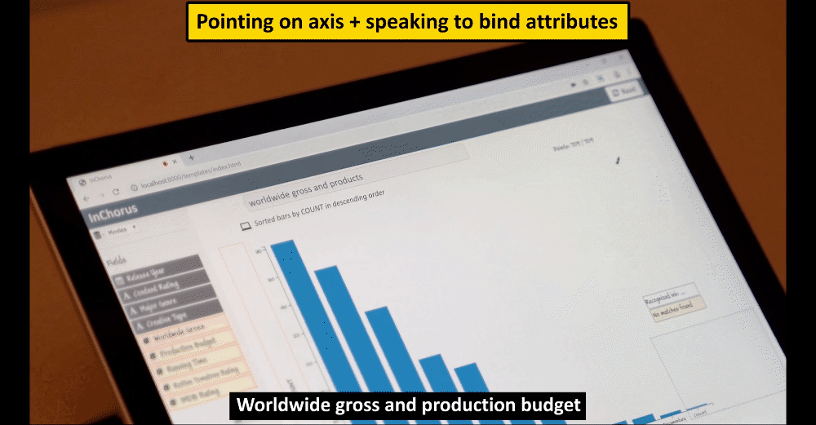
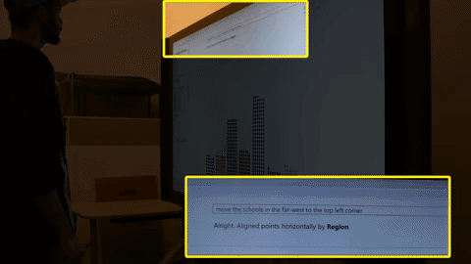
Natural Language as Input for Visualization Systems: Designing Fluid Interaction Experiences
IEEE VIS 2017
ACM CHI 2020
IEEE TVCG 2020

Slide 5
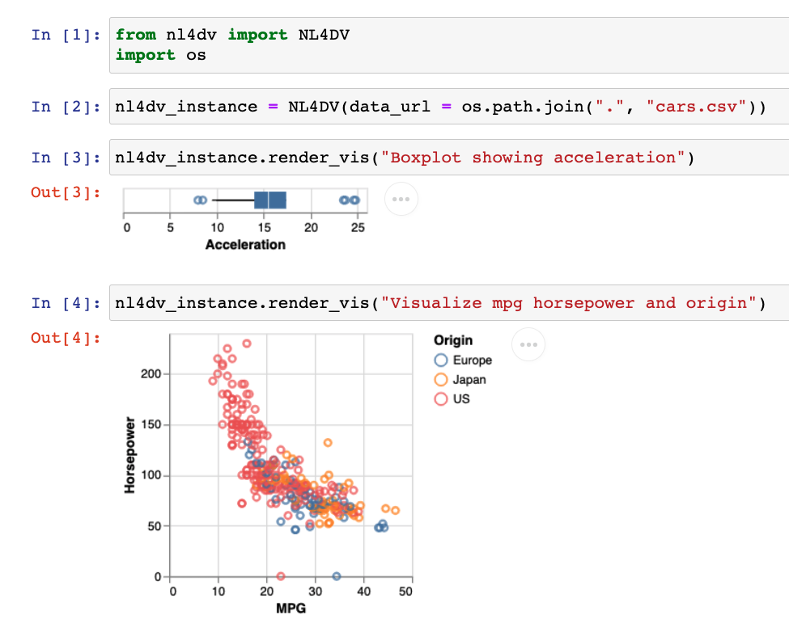
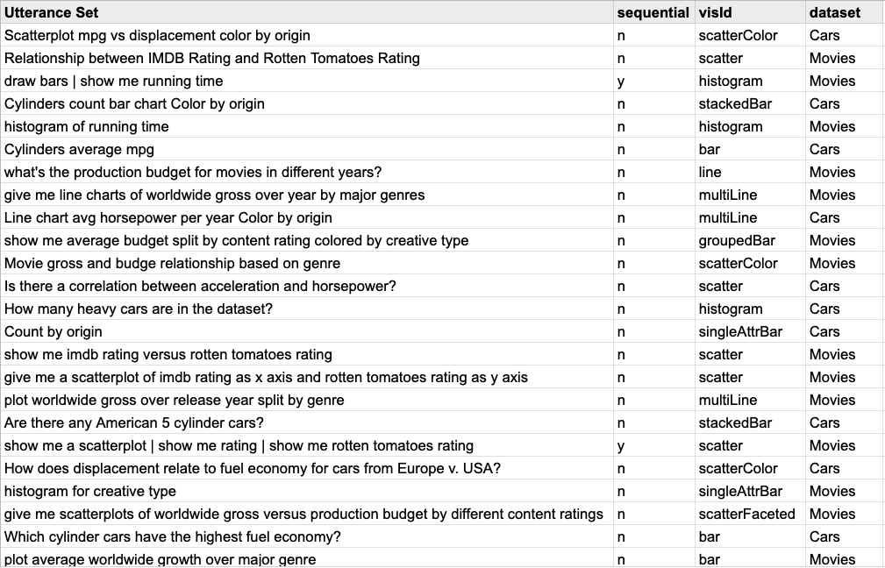


Natural Language as Input for Visualization Systems: Developer Resources
nl4dv.github.io
nlvcorpus.github.io
IEEE VIS 2020
ACM CHI 2021

Slide 6
Visualizations
Natural Language Output
Humans
Visualization Systems

Slide 7
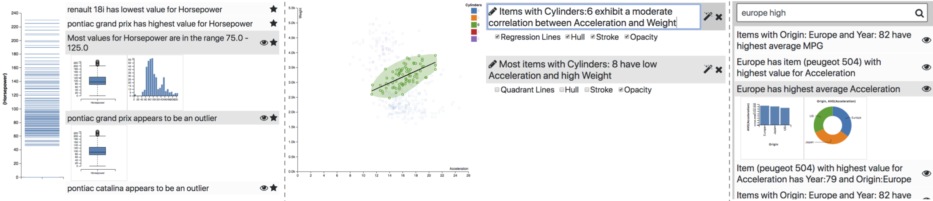
Natural Language as Output from Visualization Systems: Recommendations to guide analysis and communication
Augmenting Visualizations with Interactive “Data Facts”, IEEE VIS 2018
Utterance Recommendations for Conversational Visual Analysis, ACM UIST 2021

Slide 8



Humans
Visualization Systems

Slide 9





Can we leverage NL in data-driven communication tools? What are the opportunities and challenges?
What are the challenges and potential tasks for curating large-scale (NL+VIS) datasets?
What type of data facts do people care about? When and how should these be presented? What are the risks/benefits of “auto-insight” systems?
How can we leverage NL, audio, and/or other modalities to improve accessibility?
Humans
Visualization Systems

Slide 10
Thank You
Arjun Srinivasan
Tableau Research
Can we leverage NL in data-driven communication tools? What are the opportunities and challenges?
What are the challenges and potential tasks for curating large-scale (NL+VIS) datasets?
What type of data facts do people care about? When and how should these be presented? What are the risks/benefits of “auto-insight” systems?
How can we leverage NL, audio, and/or other modalities to improve accessibility?
Humans
Visualization Systems

